Slide 1
Testing for Selection in Genes
GDW2017
Colorado State University
Slatteryjp@si.edu
Jill.Pecon.Slattery@gmail.com www.cornerstonegenomics.com

Slide 2
Testing Coding Regions for Adaptive Evolution
Is there evidence of selection operating on a gene?
Where does selection occur within the gene? What regions, motifs, amino acids are under selection?
Mapping the selection event on the phylogenetic tree. Is there a specific species or lineage that is experiencing selection?
Assessing the form of selection (i.e. negative or positive) and identifying the codon (s), and a priori testing for statistical rigor.
Are other genes exhibiting compensatory changes coincident with selection?

Slide 3
Testing for Selection in Aligned Sequences
Aligned codon sequences must be in frame with no stop codons.
Remove recombination motifs and/or analyze partitions of MSA that are confirmed identical by descent.
Permits unbiased estimates of parameters
A resolved phylogenetic tree of the multiple sequence file.
Pre-existing species tree established from other analyses
A poorly resolved tree will be unable to adequately test for selection and result in spurious results.

Slide 4
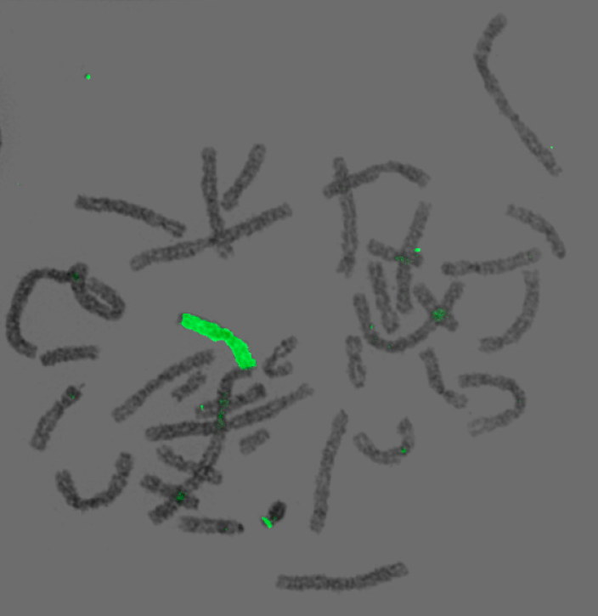
Testing hypothesis that Y-linked genes are correlated with speciation
In placental mammals only genes in the small pseudoautosomal region of Y undergo conventional recombination with X during male meiosis.
AND:
Most functional genes on the Y are in the non-recombining region
How do they maintain function?
Mueller’s ratchet predicts deleterious mutations must accumulate in the absence of recombination
countered by:
strong selection for male function
Notes:
So what are the predicted conseqeunces?

Slide 5
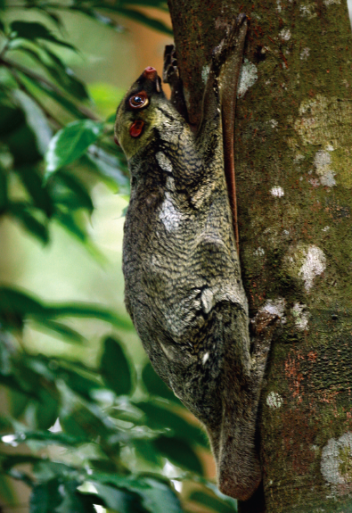
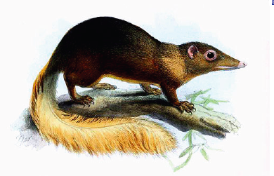
Molecular Phylogeny of 186 primates, 5 outgroup taxa, rooted by Lagomorpha
Highly Resolved
Bootstrap values 90-100% at 166/189 nodes
Only 3 of 189 nodes (28, 38, 158) polytomy
Systematic Hierarchy
2 Suborders
5 Infraorders
2 Parvorders
2 Superfamilies
14 Families
14 Subfamilies?
4 Tribes?
Resolution of Early Primate Divergence
Origin of living primates 87 MYA
Closest Mammalian Order:
Dermoptera (flying lemurs)
Scandentia (tree shrews)
87 MYA
Perelman P, Johnson WE, Roos C, Seuánez HN, Horvath JE, et al. (2011) A Molecular Phylogeny of Living Primates. PLOS Genetics 7(3): e1001342. https://doi.org/10.1371/journal.pgen.1001342
http://journals.plos.org/plosgenetics/article?id=10.1371/journal.pgen.1001342

Slide 6
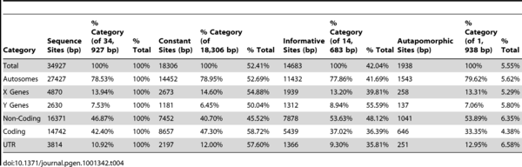

Partitions of Informative Markers
Table 4. Sequence Variation by Gene Category and Data Partition in Primate Phylogeny after Correction For Ambiguous Sites.
Perelman P, Johnson WE, Roos C, Seuánez HN, Horvath JE, et al. (2011) A Molecular Phylogeny of Living Primates. PLOS Genetics 7(3): e1001342. https://doi.org/10.1371/journal.pgen.1001342
http://journals.plos.org/plosgenetics/article?id=10.1371/journal.pgen.1001342

Slide 7
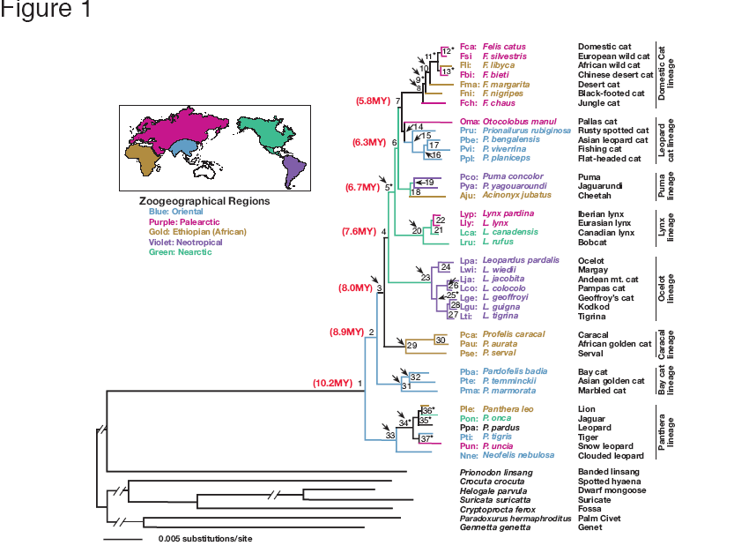

Slide 8
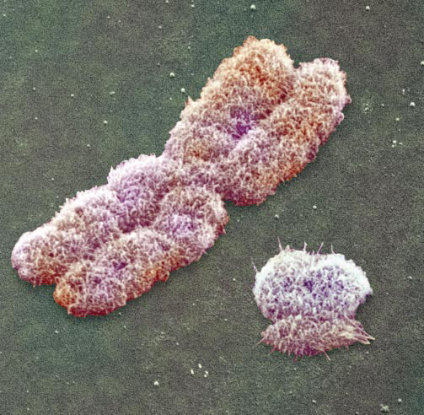
The Y-Chromosome and Speciation
Genes on the Y are accumulating mutations at a faster rate that those of the X or autosomes
Male Driven Evolution
Genes on the Y accumulate mutations diagnostic for species phylogeny with high accuracy.
Notes:
.

Slide 11
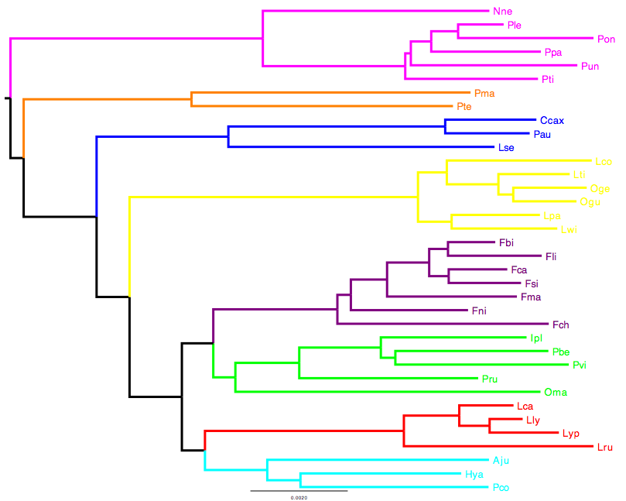
Estimates of Male–Driven Evolution Using Branch Lengths of Felidae Phylogeny
Y/A = 9.92/6.51
=1.52
X/A = 4.35/6.51
= 0.67
Y/X = 9.92/4.35
= 2.28

Slide 12
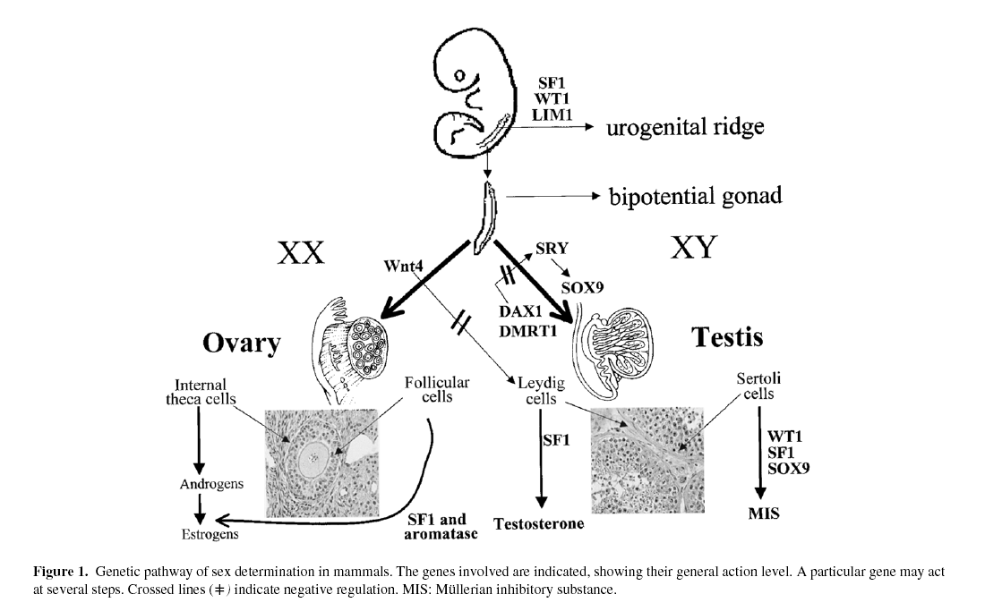
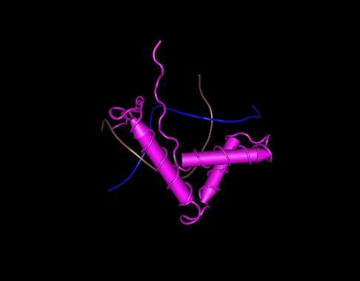
SRY: the mammalian male determining gene

Slide 13
Combined data of noncoding 5’ flank, SRY gene, and 3’noncoding flank (2659 bp)
Species Lineage
52 / * /*
Felis libyca
African wild cat
European wild cat
Domestic cat
Chinese desert cat
Sand cat
Black-footed cat
Jungle cat
Pallas cat
Flat-headed cat
Asian leopard cat
Fishing cat
Rusty-spotted cat
Cheetah
Jaguarondi
Puma
Siberian lynx
Canadian lynx
Iberian lynx
Bobcat
Tigrina
Kodkod
Geoffroy’s cat
Pampas cat
Ocelot
Margay
Serval
Caracal
African golden cat
Marbled cat
Asian golden cat
Clouded leopard
Leopard
Lion
Jaguar
Tiger
Snow leopard
79 /77 /69
Felis silvestris
79 /89 /91
Felis catus
Domestic Cat
Asian Leopard Cat
Puma
Lynx
Ocelot
Caracal
Bay Cat
Panthera
* /79 /57
Felis bieti
100 /100 /100
Felis margarita
Felis nigripes
76 /87 /83
91 /77 /74
Felis chaus
Otocolobus manul
59 /50 /52
Prionailurus planiceps
97 /100 /99
Prionailurus bengalensis
* / * /60
98 /96 /94
Prionailurus viverrinus
93 /88 /96
Prionailurus rubiginosus
Acinonyx jubatus
99 / 99 / 100
Puma yagouaroundi
Puma concolor
92 /95 /99
Lynx lynx
Lynx canadensis
99 /100 /100
Lynx pardinus
Lynx rufus
98 /100 / 100
Leopardus tigrinus
90 / 89 / 94
90/94/97
Leopardus guigna
99 /100 /100
100 /100 /100
Leopardus geoffroyi
Leopardus colocolo
74 /71 /64
Leopardus pardalis
100 /100 /100
Leopardus weidii
Caracal serval
99 / 100 /98
79 /81/82
100 / 100 / 100
Caracal caracal
Caracal aurata
99 / 97 / 98
100 /100 /100
Pardofelis marmorata
Pardofelis temminckii
50/53/98
Neofelis nebulosa
Panthera pardus
*/ * / *
Panthera leo
Panthera onca
Panthera tigris
0.005 substitutions/site
Panthera uncia

Slide 14
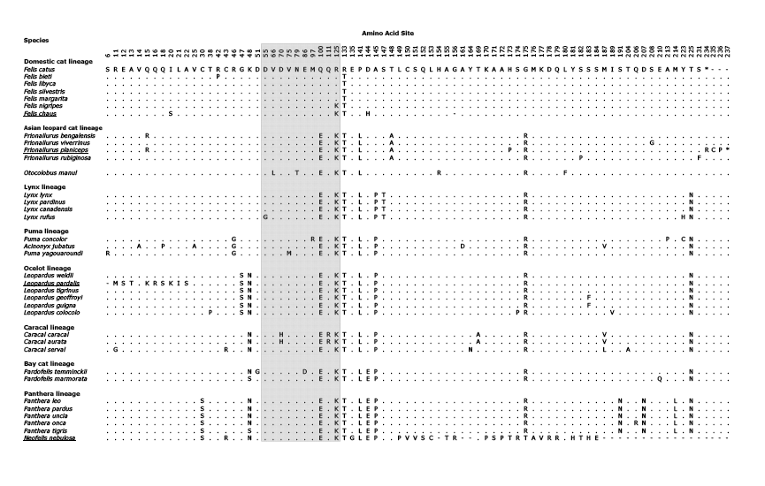
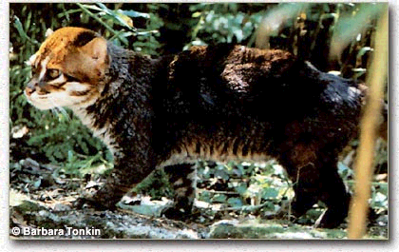
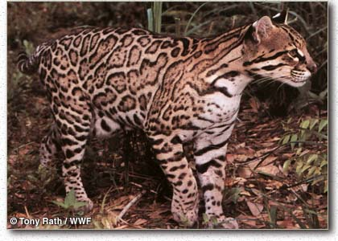
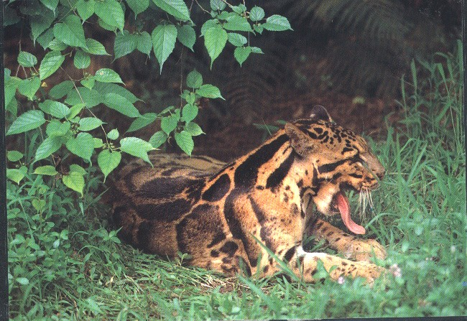
Variable sites of Amino Acid Substitutions
Jungle cat
Frame shift 143
Δ173-234
Stop codon
Δ1-6
Δ156

Flat-headed cat
Ocelot
Clouded leopard

Slide 15
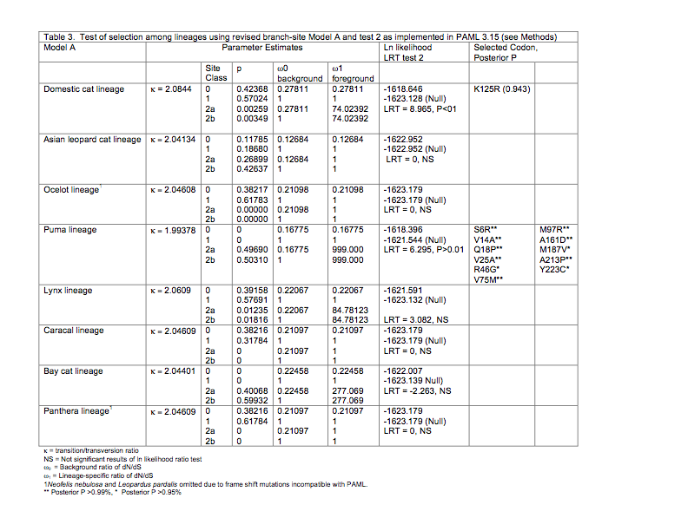
Tests for Selection in SRY: Maximum Likelihood Approach (PAML)
Revised branch-site Model A and Test 2

Slide 16
INTERPRETATION OF MODELS
Like humans, SRY in felids shares conserved HMG box.
The HMG box accumulating mutations at about 50% the rate of NH3 and COOH domains.
SRY evolves in close association with patterns of felid evolution.
Models of adaptation support SRY is under positive selection in 2 of the 8 felid lineages.
Different natural history of lineages may provide context for interpreting these patterns.

Slide 17
Detecting Selection in Protein Coding Sequences with PAML
PAML: Phylogenetic Analysis by Maximum Likelihood (ver 4.9d)
Author: Ziheng Yang
z.yang@ucl.ac.uk

Slide 18
Why Use PAML?
PAML offers a rigorous maximum likelihood algorithm to detect selection.
Conservative: Reduces the risk of a false positive result.
Codon models incorporate empirical sequence characteristics
Instantaneous rate matrix
Transition: transversion bias
Codon frequency bias (due to redundancy in genetic code)

Slide 19
Categories of Codon Selection Models
Among sites:
Ho: Variable selection pressure possible among sites within YGOI (your-gene-of-interest) but no sites exhibit positive selection
Among branches:
Ho: Average dN/dS is the same among all branches in the phylogeny for YGOI.
Among clades:
Ho: Average dN/dS for YGOI is the same for each lineage within the phylogeny
Branch-site:
Ho: Variable selection pressure is possible among sites with YGOI and no sites exhibit positive selection in any particular lineage relative to the rest of the phylogeny.

Slide 20
Files and Format Needed for CodeML Analyses
Data file:
Nucleotide data
No stop codons
Will not work if sequence has insertion/deletion
PHYLIP format
Treefile
Topology only, no branch lengths (suggested)
Tree must reflect true phylogeny
Unresolved nodes will decrease CodeML utility
PHYLIP format
Control file (or use the new GUI interface of PAML X)
Tet file containing specific settings for analysis

Slide 21
Basic Steps to CodeML
Create 3 files: data, tree and control
Load files into GUI interface
Select Parameters for appropriate test
Depending on numbers of sequences, genetic information, pattern of mutation, length of sequence…..
CodeML can take 15 minutes, or several days, to run (Breath deeply and relax)
Record Ln likelihood value
Compare with ln likelihood of null model.
Determine significance by the log-likelihood ratio model (LRT).
2Δλ = 2 (l₁ - l₀)
Repeat analysis.
Repeat analysis again: but this time varying starting alpha, altering frequency codon bias model
Seek Convergence of Models

Slide 22
Important Result files for CodeML
MLC file contains ln likelihood, ω, proportion of sites and descriptive information (see example in Folder)
RST file contains Bayesian posterior analyses of sites under positive selection (see example in Folder)
You need both to create Table of Values (see King et al 2007) and slides in this presentation.

Slide 23
Control file: Among Sites Model M1a (Nearly Neutral)
seqfile = sry25.phy
treefile = sry25phy.tre
outfile = mlc * main result file name
noisy = 9 * 0,1,2,3,9: how much rubbish on the screen
verbose = 1 * 1: detailed output, 0: concise output
runmode = 0 * 0: user tree; 1: semi-automatic; 2: automatic
* 3: StepwiseAddition; (4,5):PerturbationNNI; -2: pairwise
seqtype = 1 * 1:codons; 2:AAs; 3:codons-->AAs
CodonFreq = 2 * 0:1/61 each, 1:F14, 2:F34, 3:codon table
clock = 0 * 0: no clock, unrooted tree, 1: clock, rooted tree
model = 0
* models for codons:
* 0:one, 1:b, 2:2 or more dN/dS ratios for branches
NSsites = 1 * 0:one w;1:neutral;2:positive; 3:discrete;4:freqs;
* 5:gamma;6:2gamma;7:beta;8:beta&w;9:beta&gamma;
* 10:beta&1+gamma; 11:beta&1>normal; 12:0&2normal; 13:3normal
icode = 0 * 0:standard genetic code; 1:mammalian mt; 2-10:see below
fi_kappa = 0 * 1: kappa fied, 0: kappa to be estimated
kappa = 1.6 * initial or fied kappa
fi_omega = 0 * 1: omega or omega_1 fied, 0: estimate
omega = 5 * initial or fied omega, for codons or codon-based AAs
ncatG = 10 * # of categories in dG of NSsites models
getSE = 0 * 0: don't want them, 1: want S.E.s of estimates
RateAncestor = 0 * (0,1,2): rates (alpha>0) or ancestral states (1 or 2)
Small_Diff = 3e-7
cleandata = 0 * remove sites with ambiguity data (1:yes, 0:no)?
method = 0 * 0: simultaneous; 1: one branch at a time

Slide 24
Control file: Among Sites Model M2a (Positive Selection)
seqfile = sry25.phy
treefile = sry25phy.tre
outfile = mlc * main result file name
noisy = 9 * 0,1,2,3,9: how much rubbish on the screen
verbose = 1 * 1: detailed output, 0: concise output
runmode = 0 * 0: user tree; 1: semi-automatic; 2: automatic
* 3: StepwiseAddition; (4,5):PerturbationNNI; -2: pairwise
seqtype = 1 * 1:codons; 2:AAs; 3:codons-->AAs
CodonFreq = 2 * 0:1/61 each, 1:F14, 2:F34, 3:codon table
clock = 0 * 0: no clock, unrooted tree, 1: clock, rooted tree
model = 0
* models for codons:
* 0:one, 1:b, 2:2 or more dN/dS ratios for branches
NSsites = 2 * 0:one w;1:neutral;2:positive; 3:discrete;4:freqs;
* 5:gamma;6:2gamma;7:beta;8:beta&w;9:beta&gamma;
* 10:beta&1+gamma; 11:beta&1>normal; 12:0&2normal; 13:3normal
icode = 0 * 0:standard genetic code; 1:mammalian mt; 2-10:see below
fi_kappa = 0 * 1: kappa fied, 0: kappa to be estimated
kappa = 1.6 * initial or fied kappa
fi_omega = 0 * 1: omega or omega_1 fied, 0: estimate
omega = 5 * initial or fied omega, for codons or codon-based AAs
ncatG = 10 * # of categories in dG of NSsites models
getSE = 0 * 0: don't want them, 1: want S.E.s of estimates
RateAncestor = 0 * (0,1,2): rates (alpha>0) or ancestral states (1 or 2)
Small_Diff = 3e-7
cleandata = 0 * remove sites with ambiguity data (1:yes, 0:no)?
method = 0 * 0: simultaneous; 1: one branch at a time

Slide 25
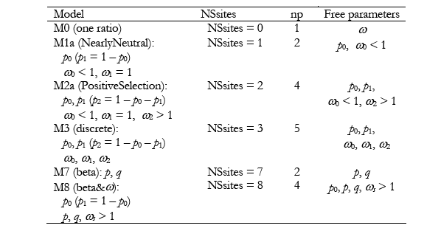
Site Models
LRT
Model M1a and Model M2a, 2 df
Model M7 and Model M8, 2 df

Slide 26
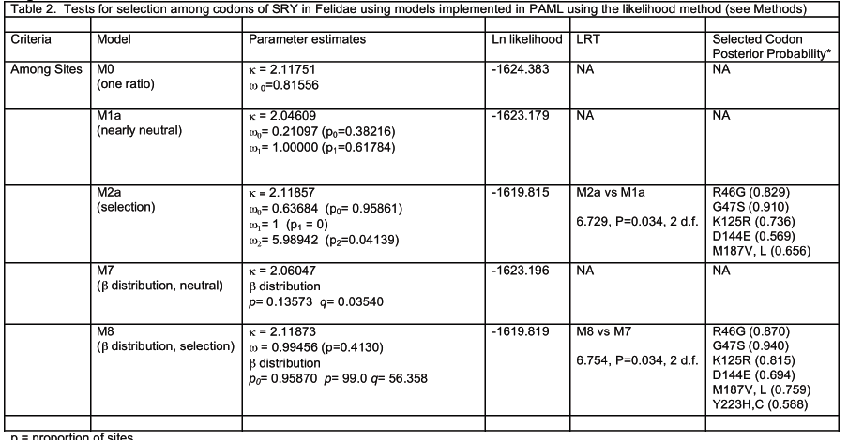
SRY: Among Site Model Results

Slide 27
Branch, Branch-site and Clade Models
Treefile must be altered to indicate which branch is to be considered.
Use TreeView to edit tree.
Use number #1 to indicate branch
Use $ to indicate clade.
Treefile example
(1pon,6ppa,10pun,21pti,(4nne,(9pte,16pma,(20lse,23pau,((3oma,(2fni,8fch,(5fbi,18fca,27fma)),(13pru,25pvi,(11ipl,26pbe))),(7pco,15hya,21aju)#1,(12lru,14lyp)),(17lwi,19oge,24lco)))));

Slide 28
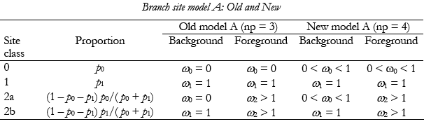
Control files
Branch-site
Model A recommended
Model = 2
NSsites=2
Compare LRT with Null Model A
Model=2
NSsites=2
But, ω=1, fixed.
Results include MLC files and Rst files which will include any BEB analyses that will identify putative sites under selection.

Slide 29
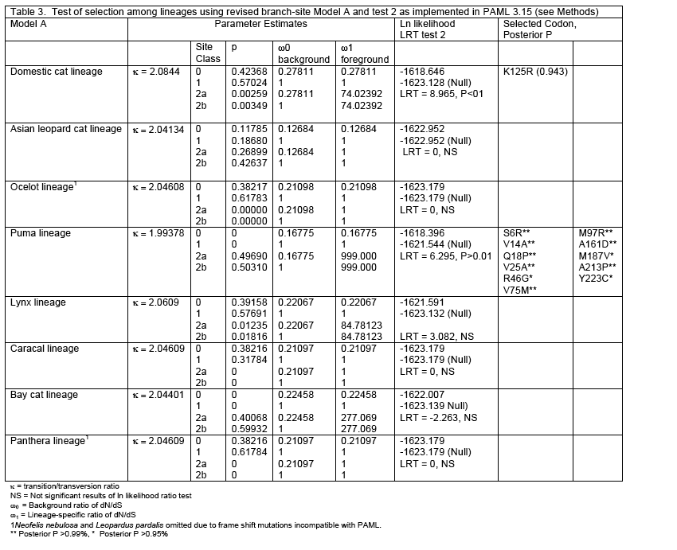
Branch-Site Models SRY

Slide 30
Exercises
Read Chapter 6 of PAML DOC as a guide for these exercises.
Load datasets provide for SRY (sequence file and a treefile)
Run Model 1 using information on control files for the slides provided in this talk. Enter these values into the GUI interface
Save output files into new folder [Model 1].
Run Model 2a after making changes in control file shown in this slide presentation. Enter into the GUI interface.
Save output into new folder entitled [Model 2a]
Find the ln likelihood values in the MLC files for both models.
Compute log likelihood using formula provided in this presentation
Look in the Rst file for BEB analyses and look for sites listed wth P-value >0.95
Repeat for Models 7 & 8 which are also among-site models with a different underlying distribution that statisticians understand….
CONGRATULATIONS! You have just completed among sites model of selection tests. PLEASE SEE KING ET AL 2007 GENETICS EVOLUTION OF SRY IN THE CAT FAMILY FELIDAE (Provided in this folder) TO HELP YOU INTERPRET AND DO ADDITIONAL ANALYSES. (Also just look at previous slide).
10) You can modify the treefile using the PAML instructions to denote which branch you wish to test in the branch –site model. Hint: Domestic cat lineage and puma lineages will have significant branch-site LRT models.

